Slide 1
How large should the RNA-seq library size be to accurately detect differential isoform usage
Summer project
Wenjun Liu
Supervisor: Stephen Pederson

Slide 2
a small percentage of genes showing differential isoform usage but no change in expression
both differential expression and alternate isoform usage
no differential isoform usage but differential expression,

Slide 3
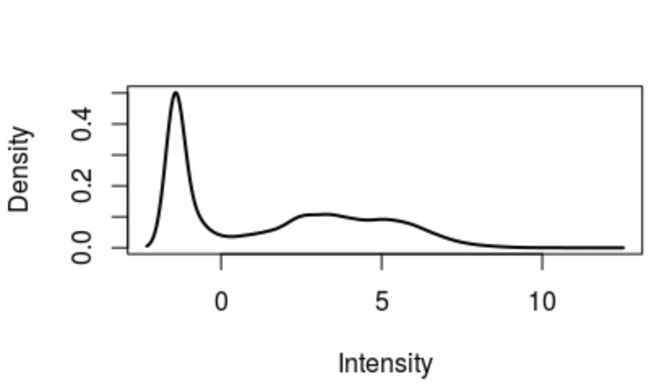
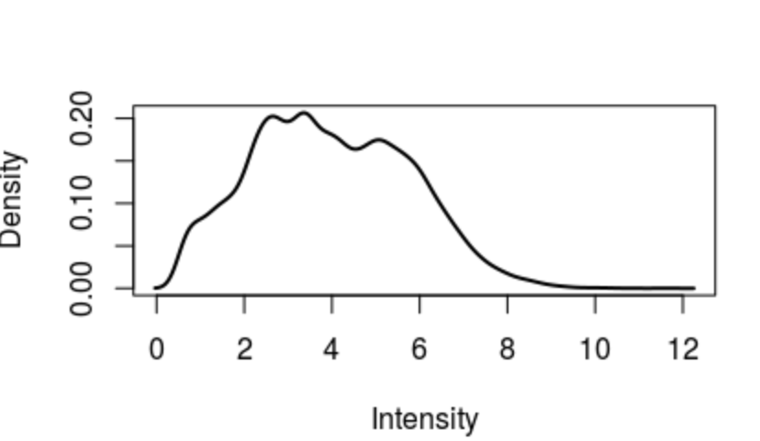
RNA-seq data simulation (no DE nor Isoform)
First Method:
Extract the longest transcripts of each human autosomal genes
Subset the extract transcripts into five group with size ratio of 4: 0.5: 1: 6: 0.5
Simulate RNA-seq reads of each transcript subset with coverage 0.5, 2, 4, 16, 64 respectively
Align the reads to genome using STAR and generate LogCPM density plot
Before filtration
After filtration(CPM > 1)

Slide 4
Before filtration
After filtration(CPM > 1)
(Law et al., 2016)

Slide 5
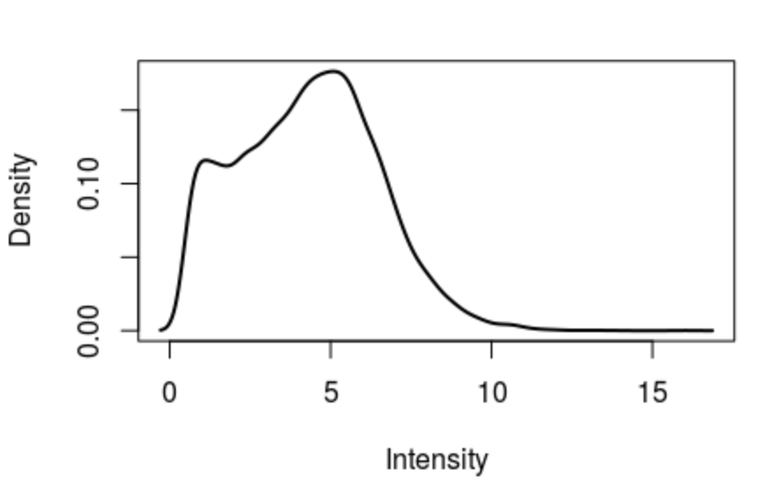
Second Method:
Obtain read counts of human genes from real data
Reserve the autosomal genes and their corresponding read counts
Extract the longest transcripts of the autosomal genes reserved
Calculate the sequencing coverage of each transcripts using read counts, read length(150bp) and transcript length
Coverage = $\frac{Count ×2×real length}{Transcript length}$
After filtration(CPM > 1)

Slide 6
Introduced Poisson noise to generate 7 replicates
Compare between 2 groups: A(Sample 1-4) : B(Sample 5-8) to see if there will be false positive DE genes
3 library sizes: ~15, 30 and 60 million reads
Two Alignment methods:
Align with STAR, calculate counts using featureCounts
Pseudo-align with Kallisto

Slide 7
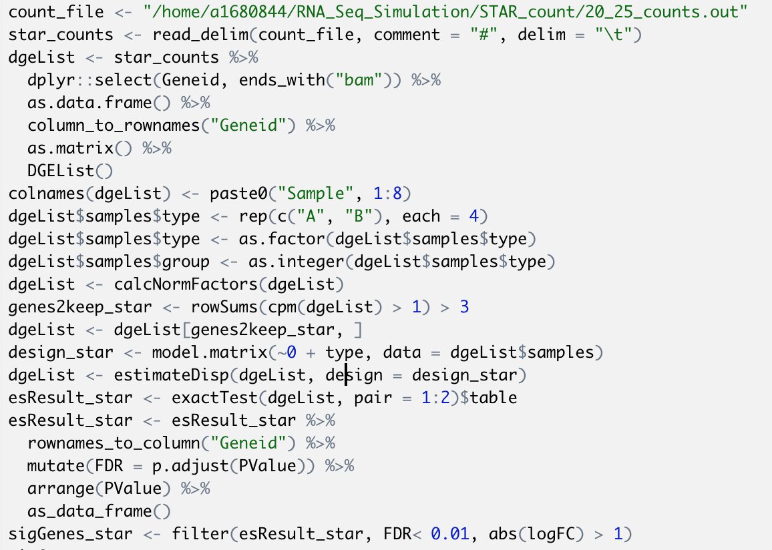
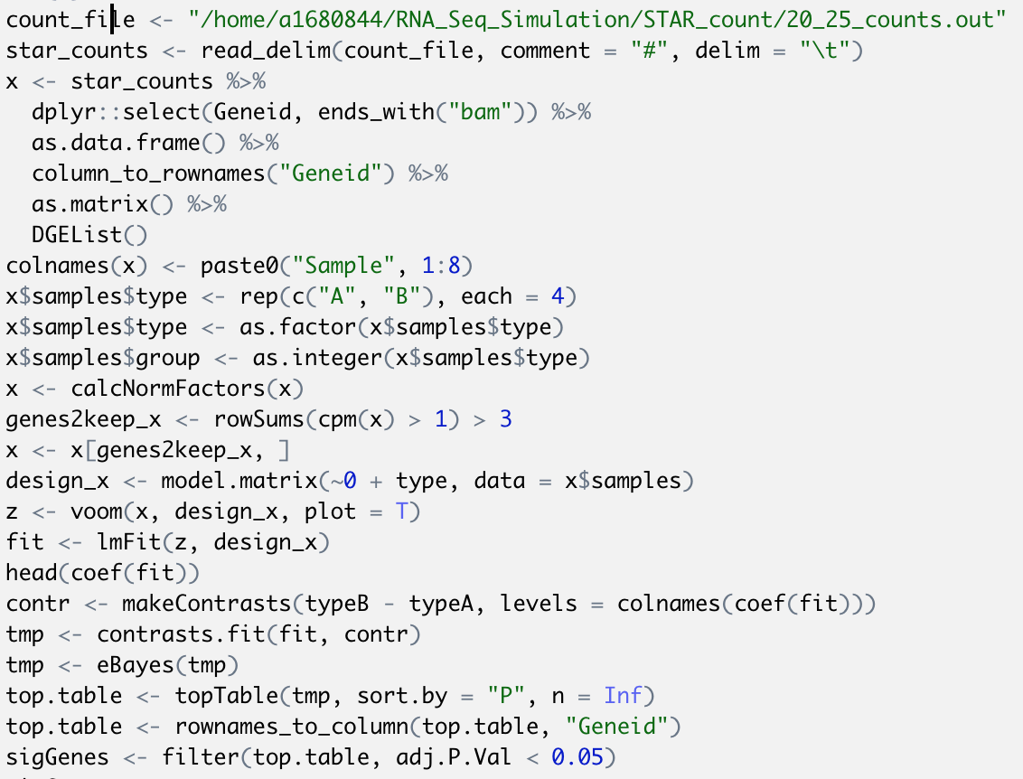
Method 1: Align with STAR, analysis with edgeR and limma/voom
edgeR
limma/voom

Slide 8
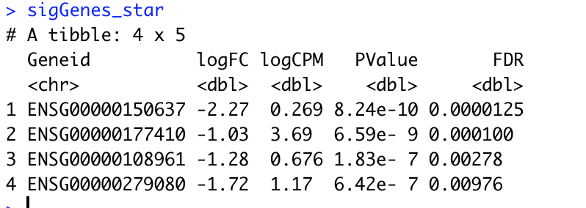
Small library: ~15 million
edgeR
limma/voom

Slide 9
Medium library: ~30 million
edgeR
limma/voom

Slide 10
Large library: ~60 million
edgeR
limma/voom

Slide 12
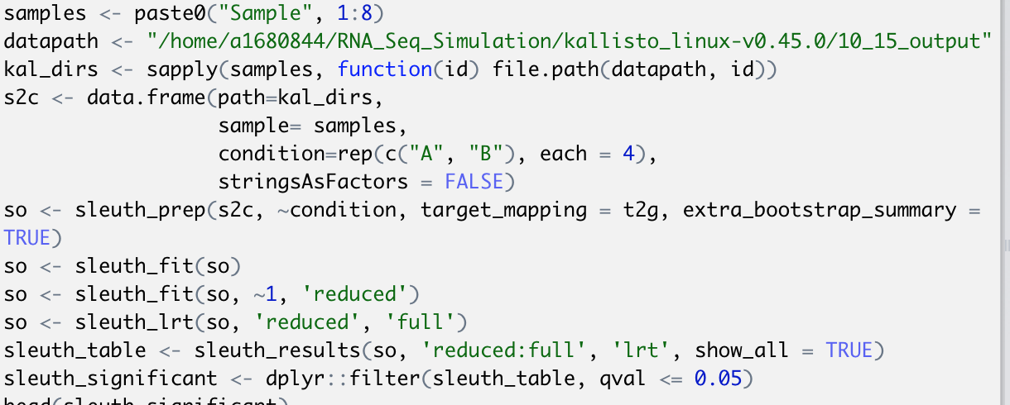
Method 2: Pseudo-align with Kallisto
Transcript level with sleuth

Slide 13
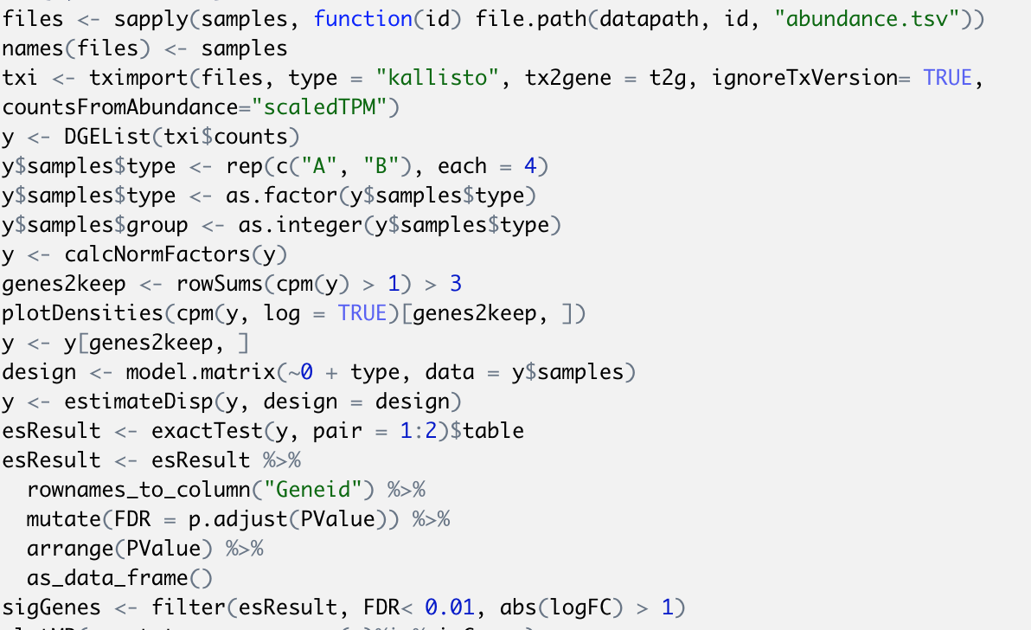
Method 2: Pseudo-align with Kallisto
Gene level with edgeR

Slide 14
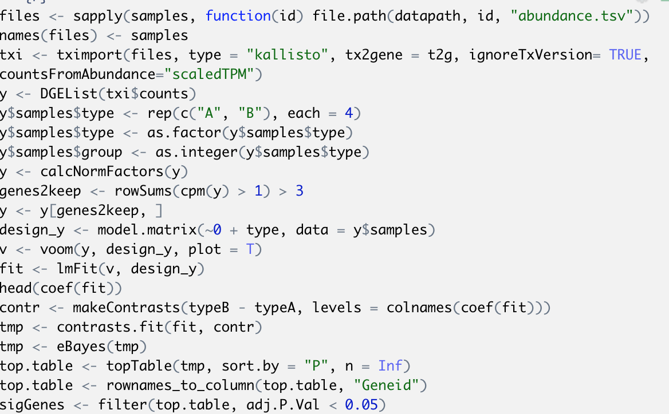
Method 2: Pseudo-align with Kallisto
Gene level with limma/voom

Slide 15
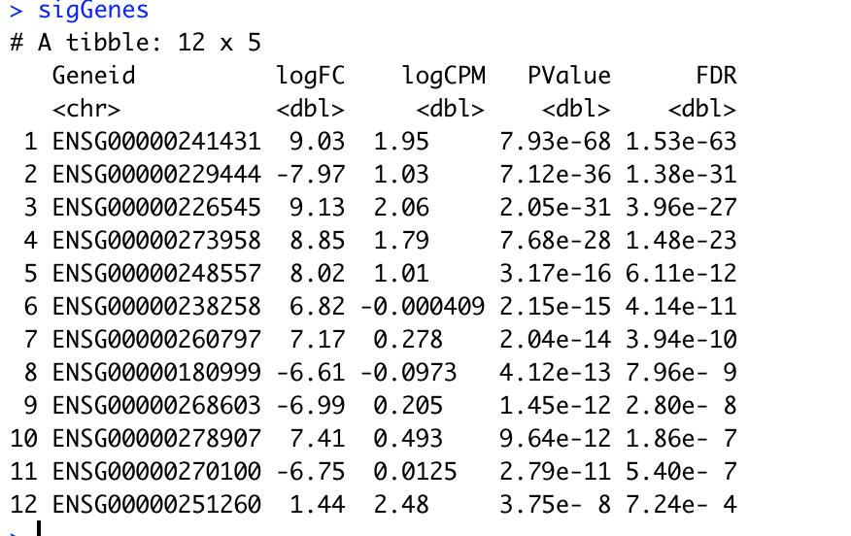
Small Library : 15 million reads
Transcript level
No differentially expressed
Transcripts
Gene level
edgeR
12 differentially expressed genes
limma/voom

Slide 16
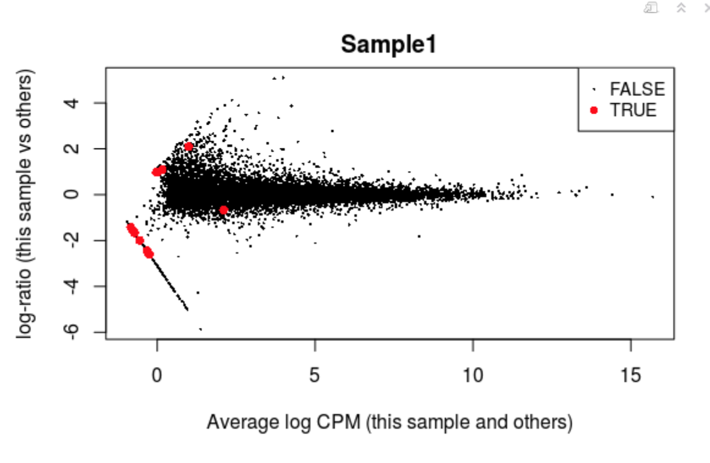

Slide 17
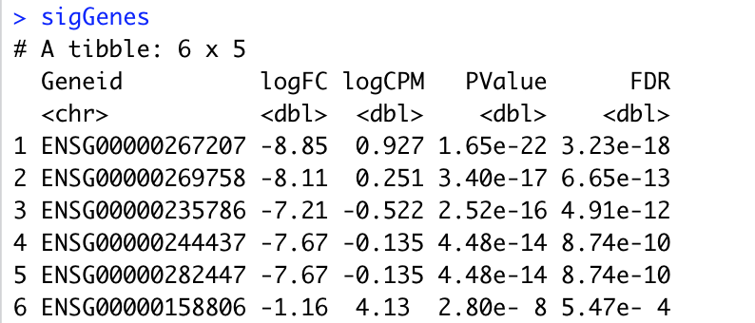
Medium Library : ~30 million reads
Transcript level
No differentially expressed transcripts
Gene level
edgeR
6 differentially expressed genes
limma/voom

Slide 18
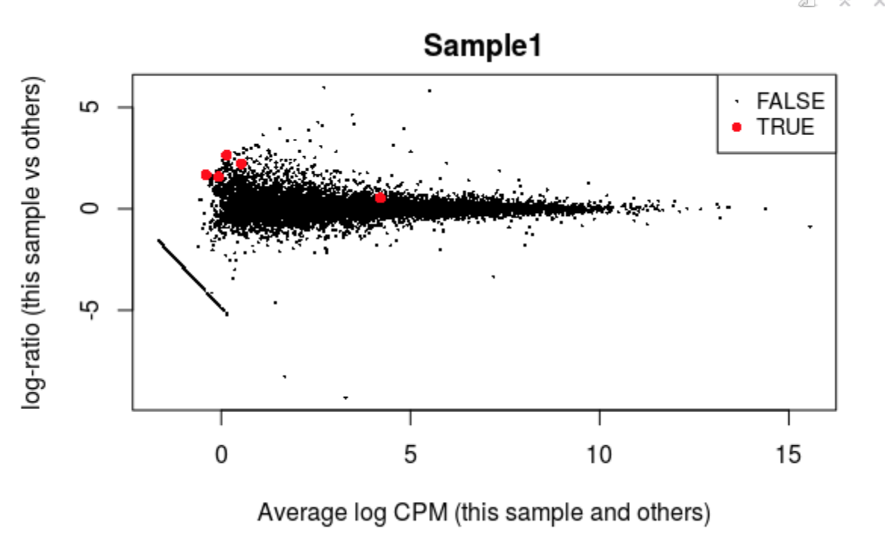
edgeR

Slide 19
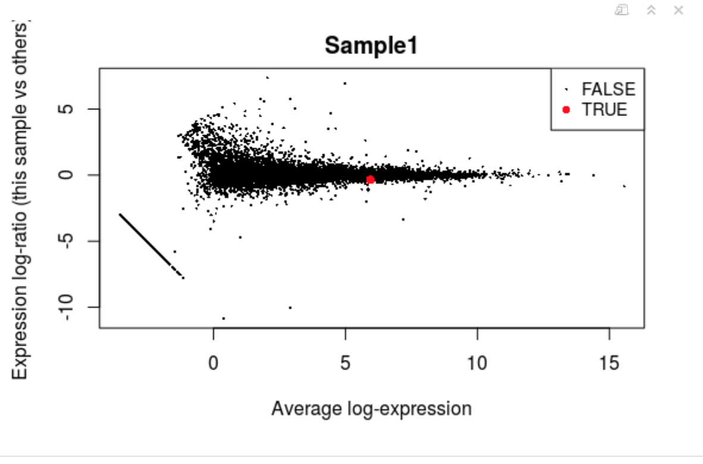
limma/voom

Slide 20
Large Library : ~60 million reads
2 differentially expressed transcripts
Transcript level
Gene level
edgeR
1 differentially expressed genes
limma/voom

Slide 21
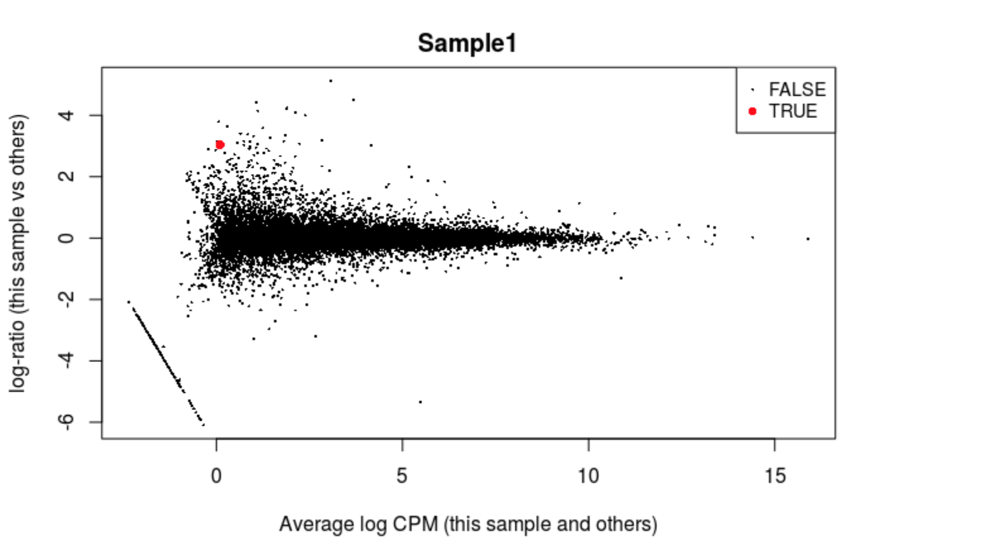

Slide 22
CatchKalliso function on transcript counts
- This function catches the transcript counts estimate by Kallisto and use the bootstrap samples to estimate an over-dispersion coefficient for each transcript.

Slide 23
Small and Large Libraries: No differentially expressed transcripts
Medium Library:

Slide 24
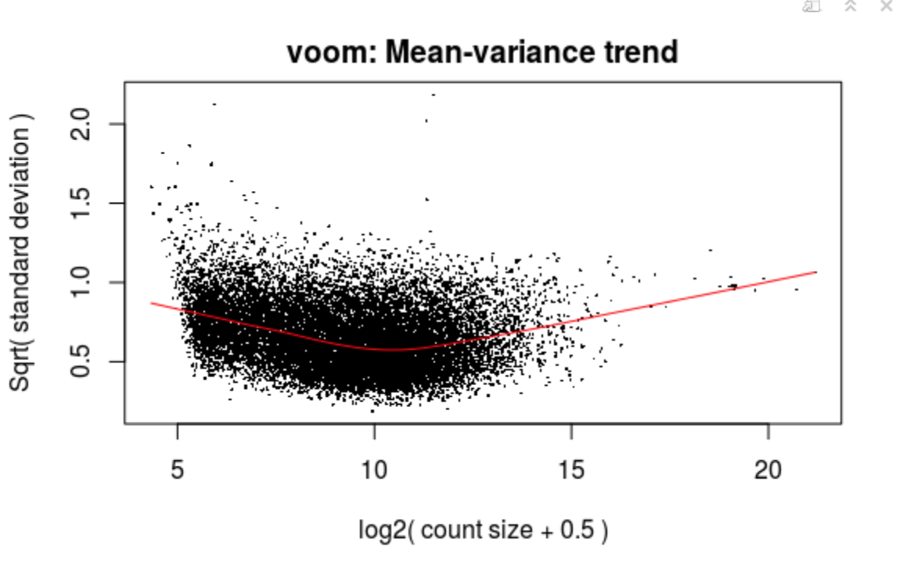
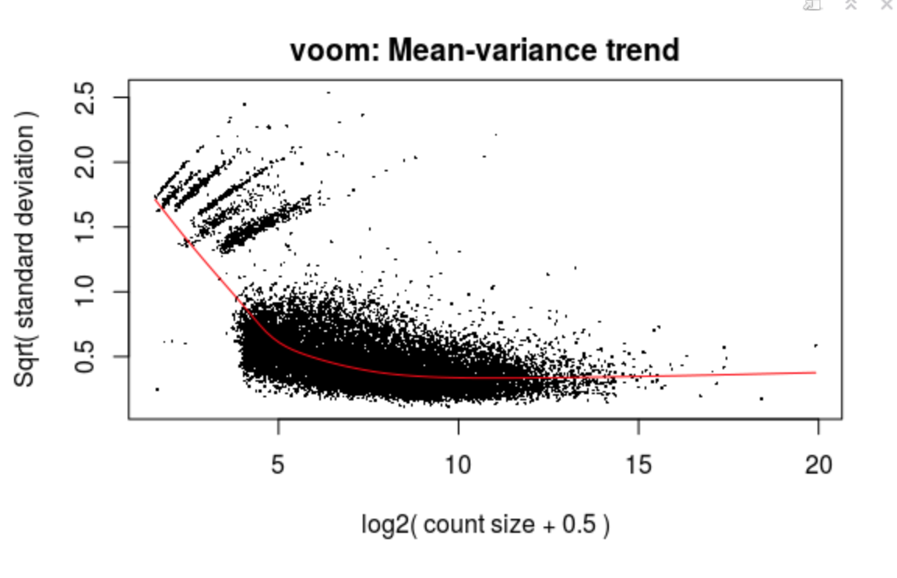
Real data
Simulated data

Slide 25
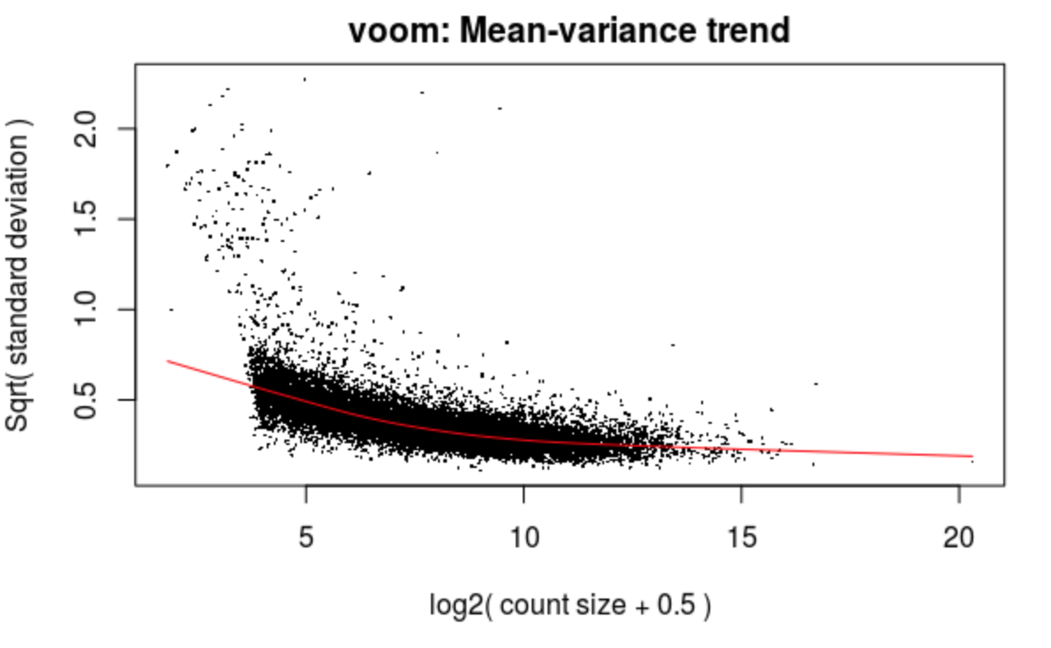
Simulated data with overdispersion
Simulated data without overdispersion

Slide 26
Differential isoform usage X Differential expression ✔
Randomly selected 1000 genes
shuffle the coverages in Sample 5-8

Slide 28
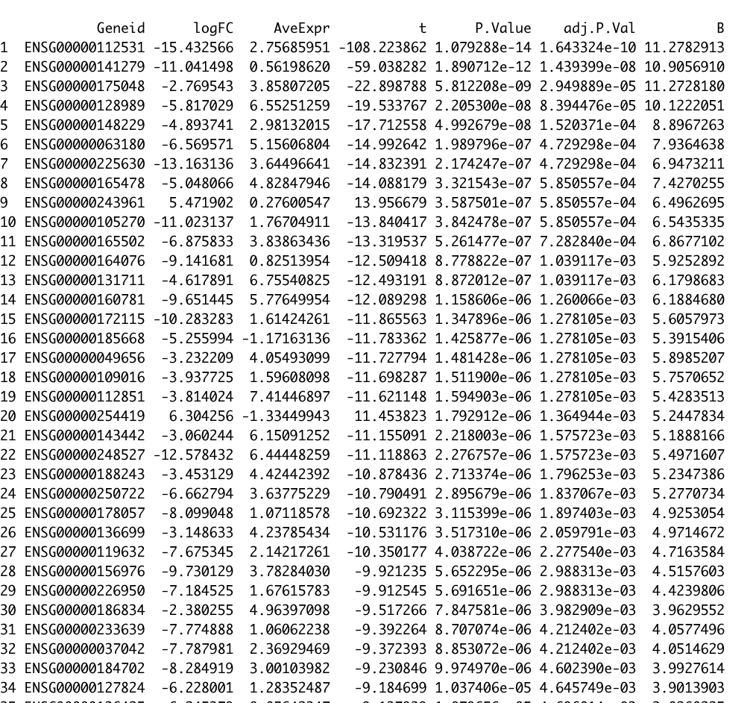
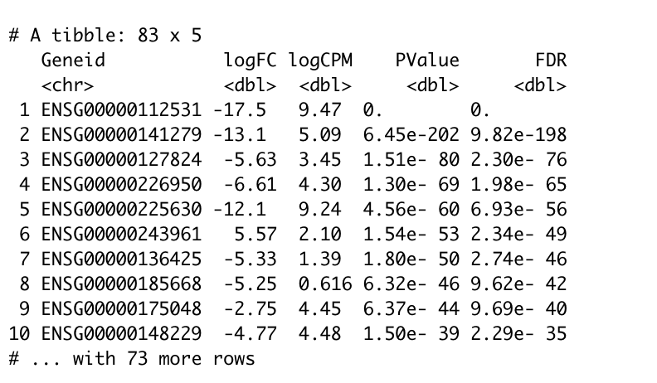
Method 1: Align with STAR, analysis with edgeR and limma/voom
Small Library : 15 million reads
edgeR
limma/voom
All of the DE genes were in the 1000 genes,
48 of them show up in both groups
83 DE genes
78 DE genes

Slide 29
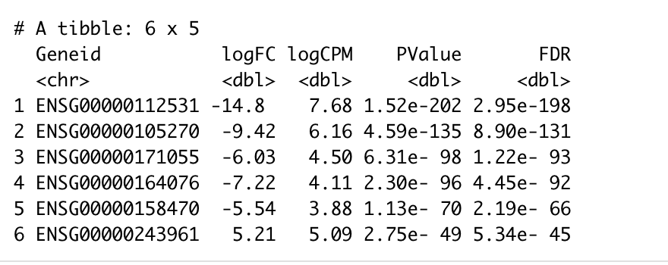
Method 2: Pseudo-align with Kallisto
Transcript level
103 DE Transcripts, 91 of which were in the 1000 genes
…
…
Gene level (edgeR)
97 DE Genes, 84 of which were in the 1000 genes
…

Slide 30
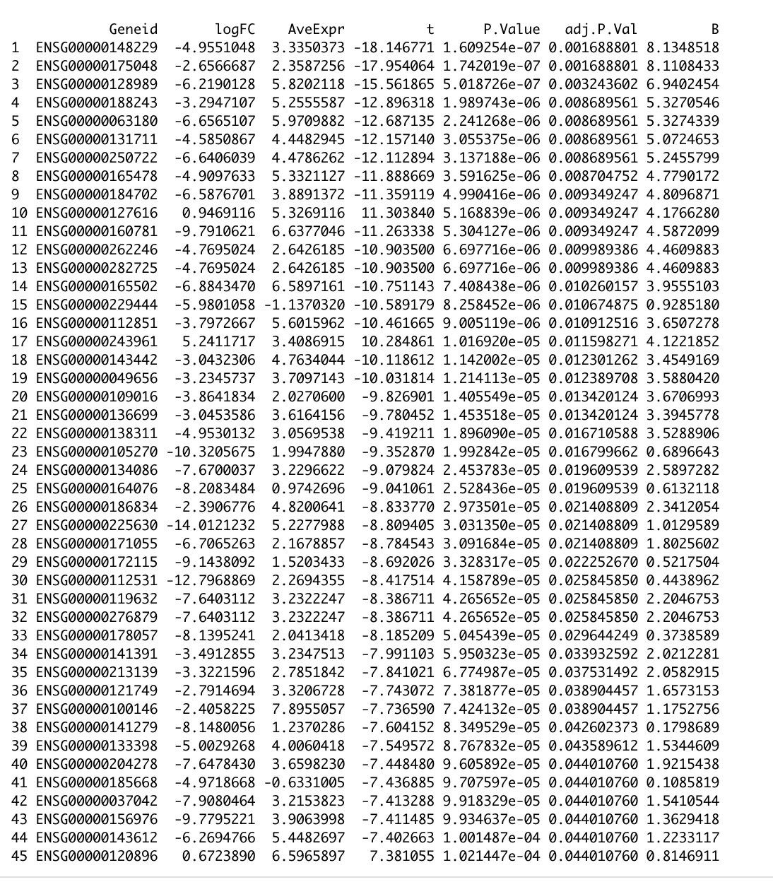
Method 2: Pseudo-align with Kallisto
Gene level (limma/voom)
…
45 DE Genes, 40 of which were in the 1000 genes
…
33 genes showed up in all the three groups, 30 of them were in STAR result too
…

Slide 31
Some thoughts …
EdgeR turns to have a higher false discovery rate than limma/voom
Kallisto’s alignment gives higher false discovery rate
Increase in library size seems to lower the false discovery rate

Slide 32
To do:
a small percentage of genes showing differential isoform usage but no change in expression
both differential expression and alternate isoform usage
no differential isoform usage but differential expression,
Adjust simulation strategy to get rid of the noises in the dispersion plot

Slide 34
