Slide 1
Sugars and aroma compounds in single grape berries
The effect of hang time and berry development
Pietro Previtali
Christopher Ford (UofA)
Dimitra Capone (UofA)
Kerry Wilkinson (UofA)
Nick Dokoozlian (E. & J. Gallo Winery)
Crush Symposium 2021

Slide 2
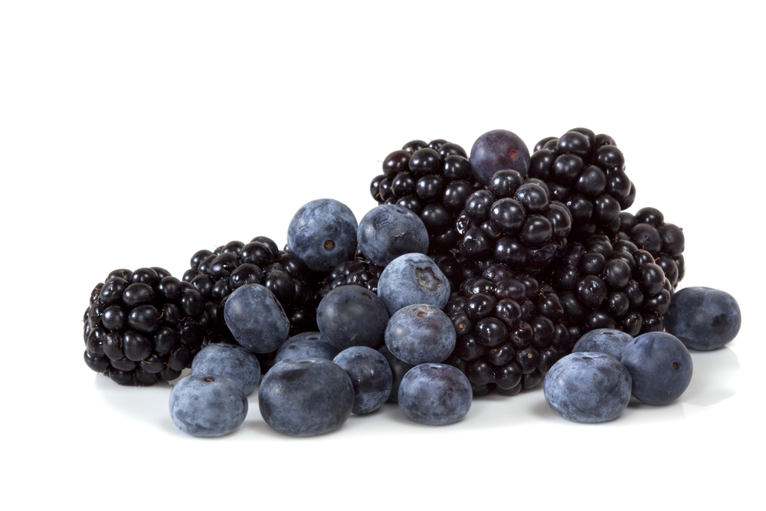
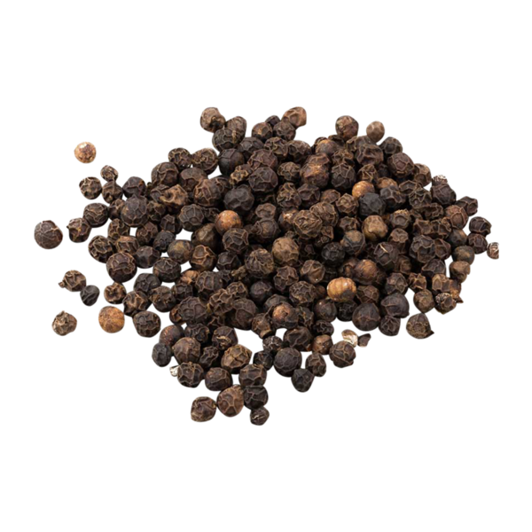
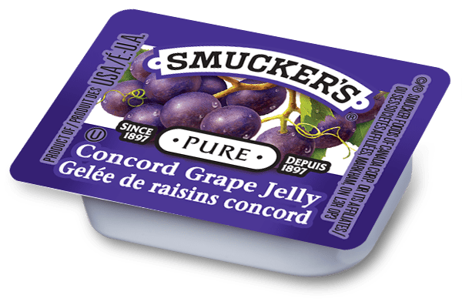
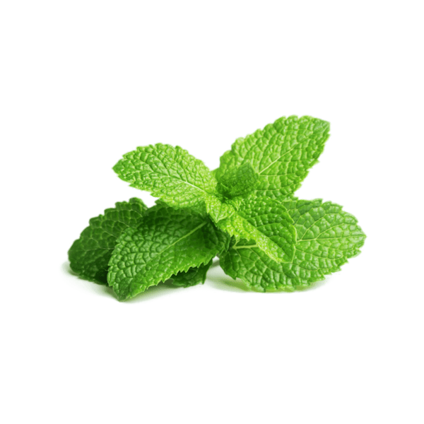
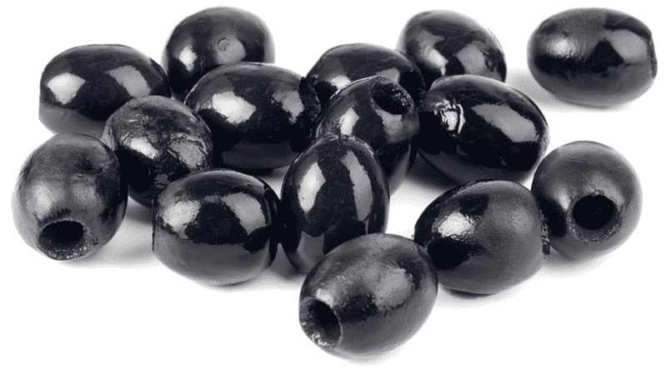
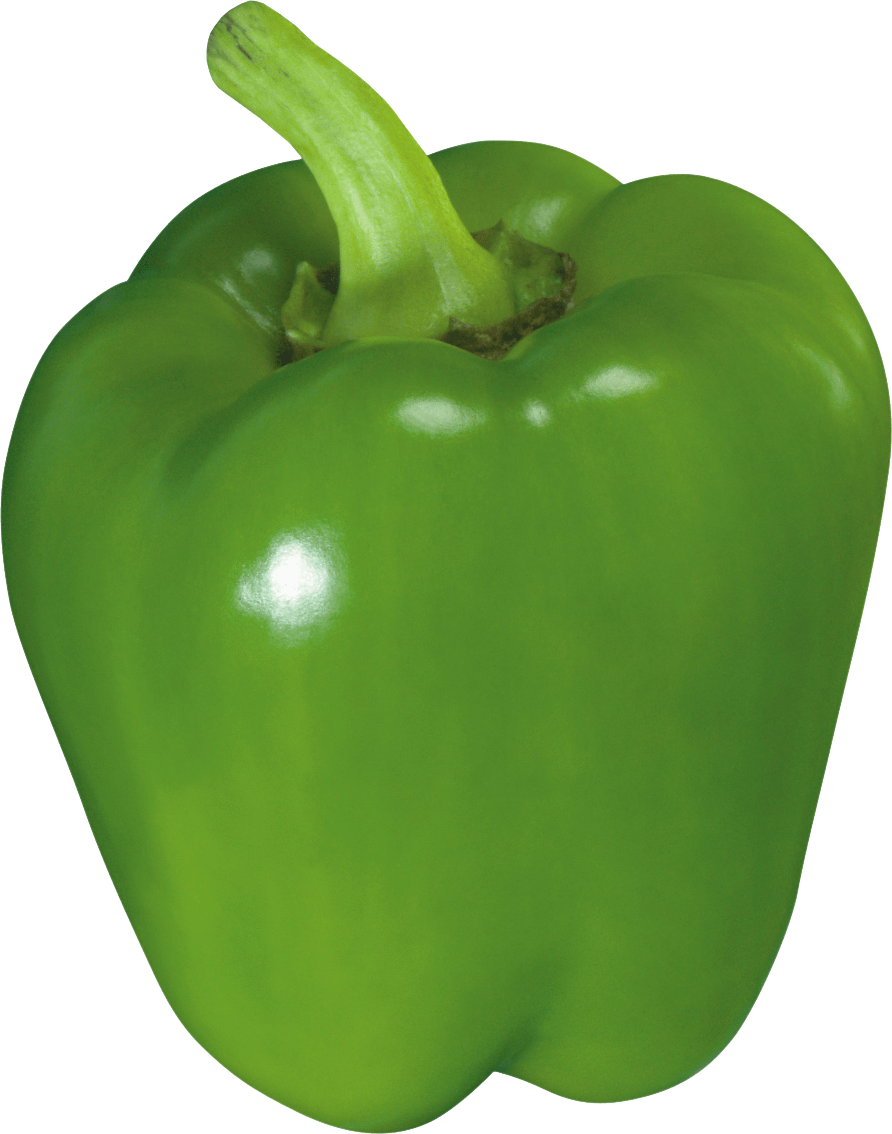
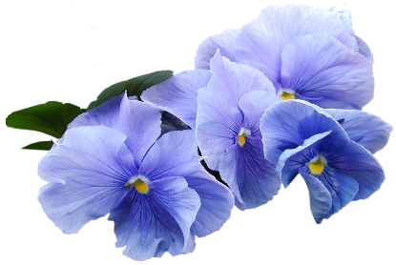
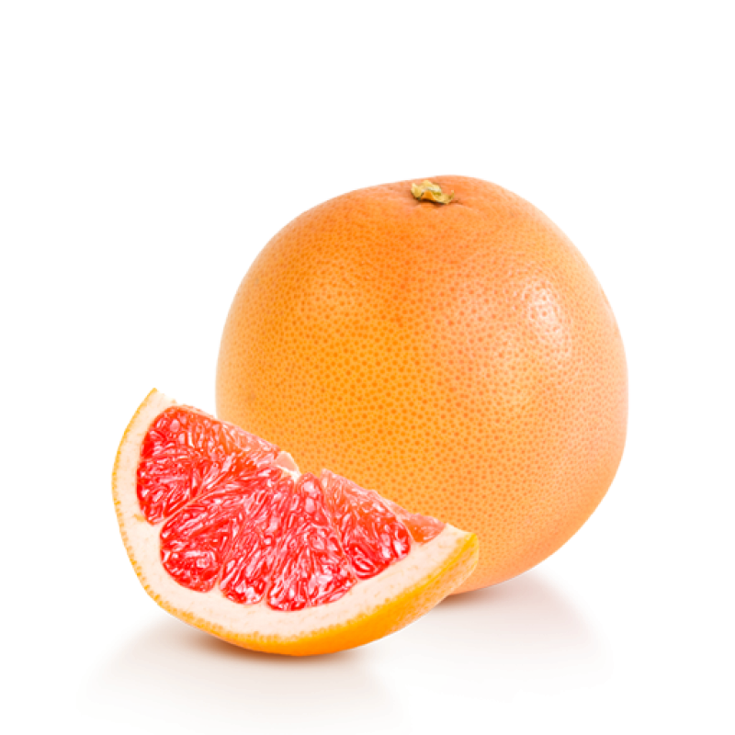
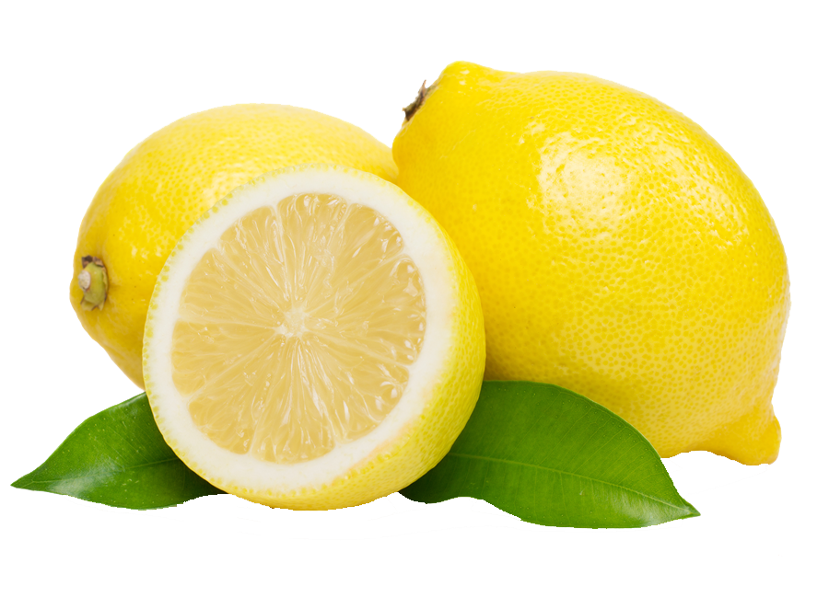
TWO KEY BERRY QUALITY TRAITS
Aroma compounds
Sugars
“Dark fruit”
“Spicy”
“Jammy”
Glucose and fructose (mainly)
“Savoury”
“Green”
“Mint”
Skin vs pulp?
“Floral”
Different concentration ranges?
“Citrus”
Effects of climate change?
Metabolic connection?
Temporal frame?
Slide 1

Slide 3
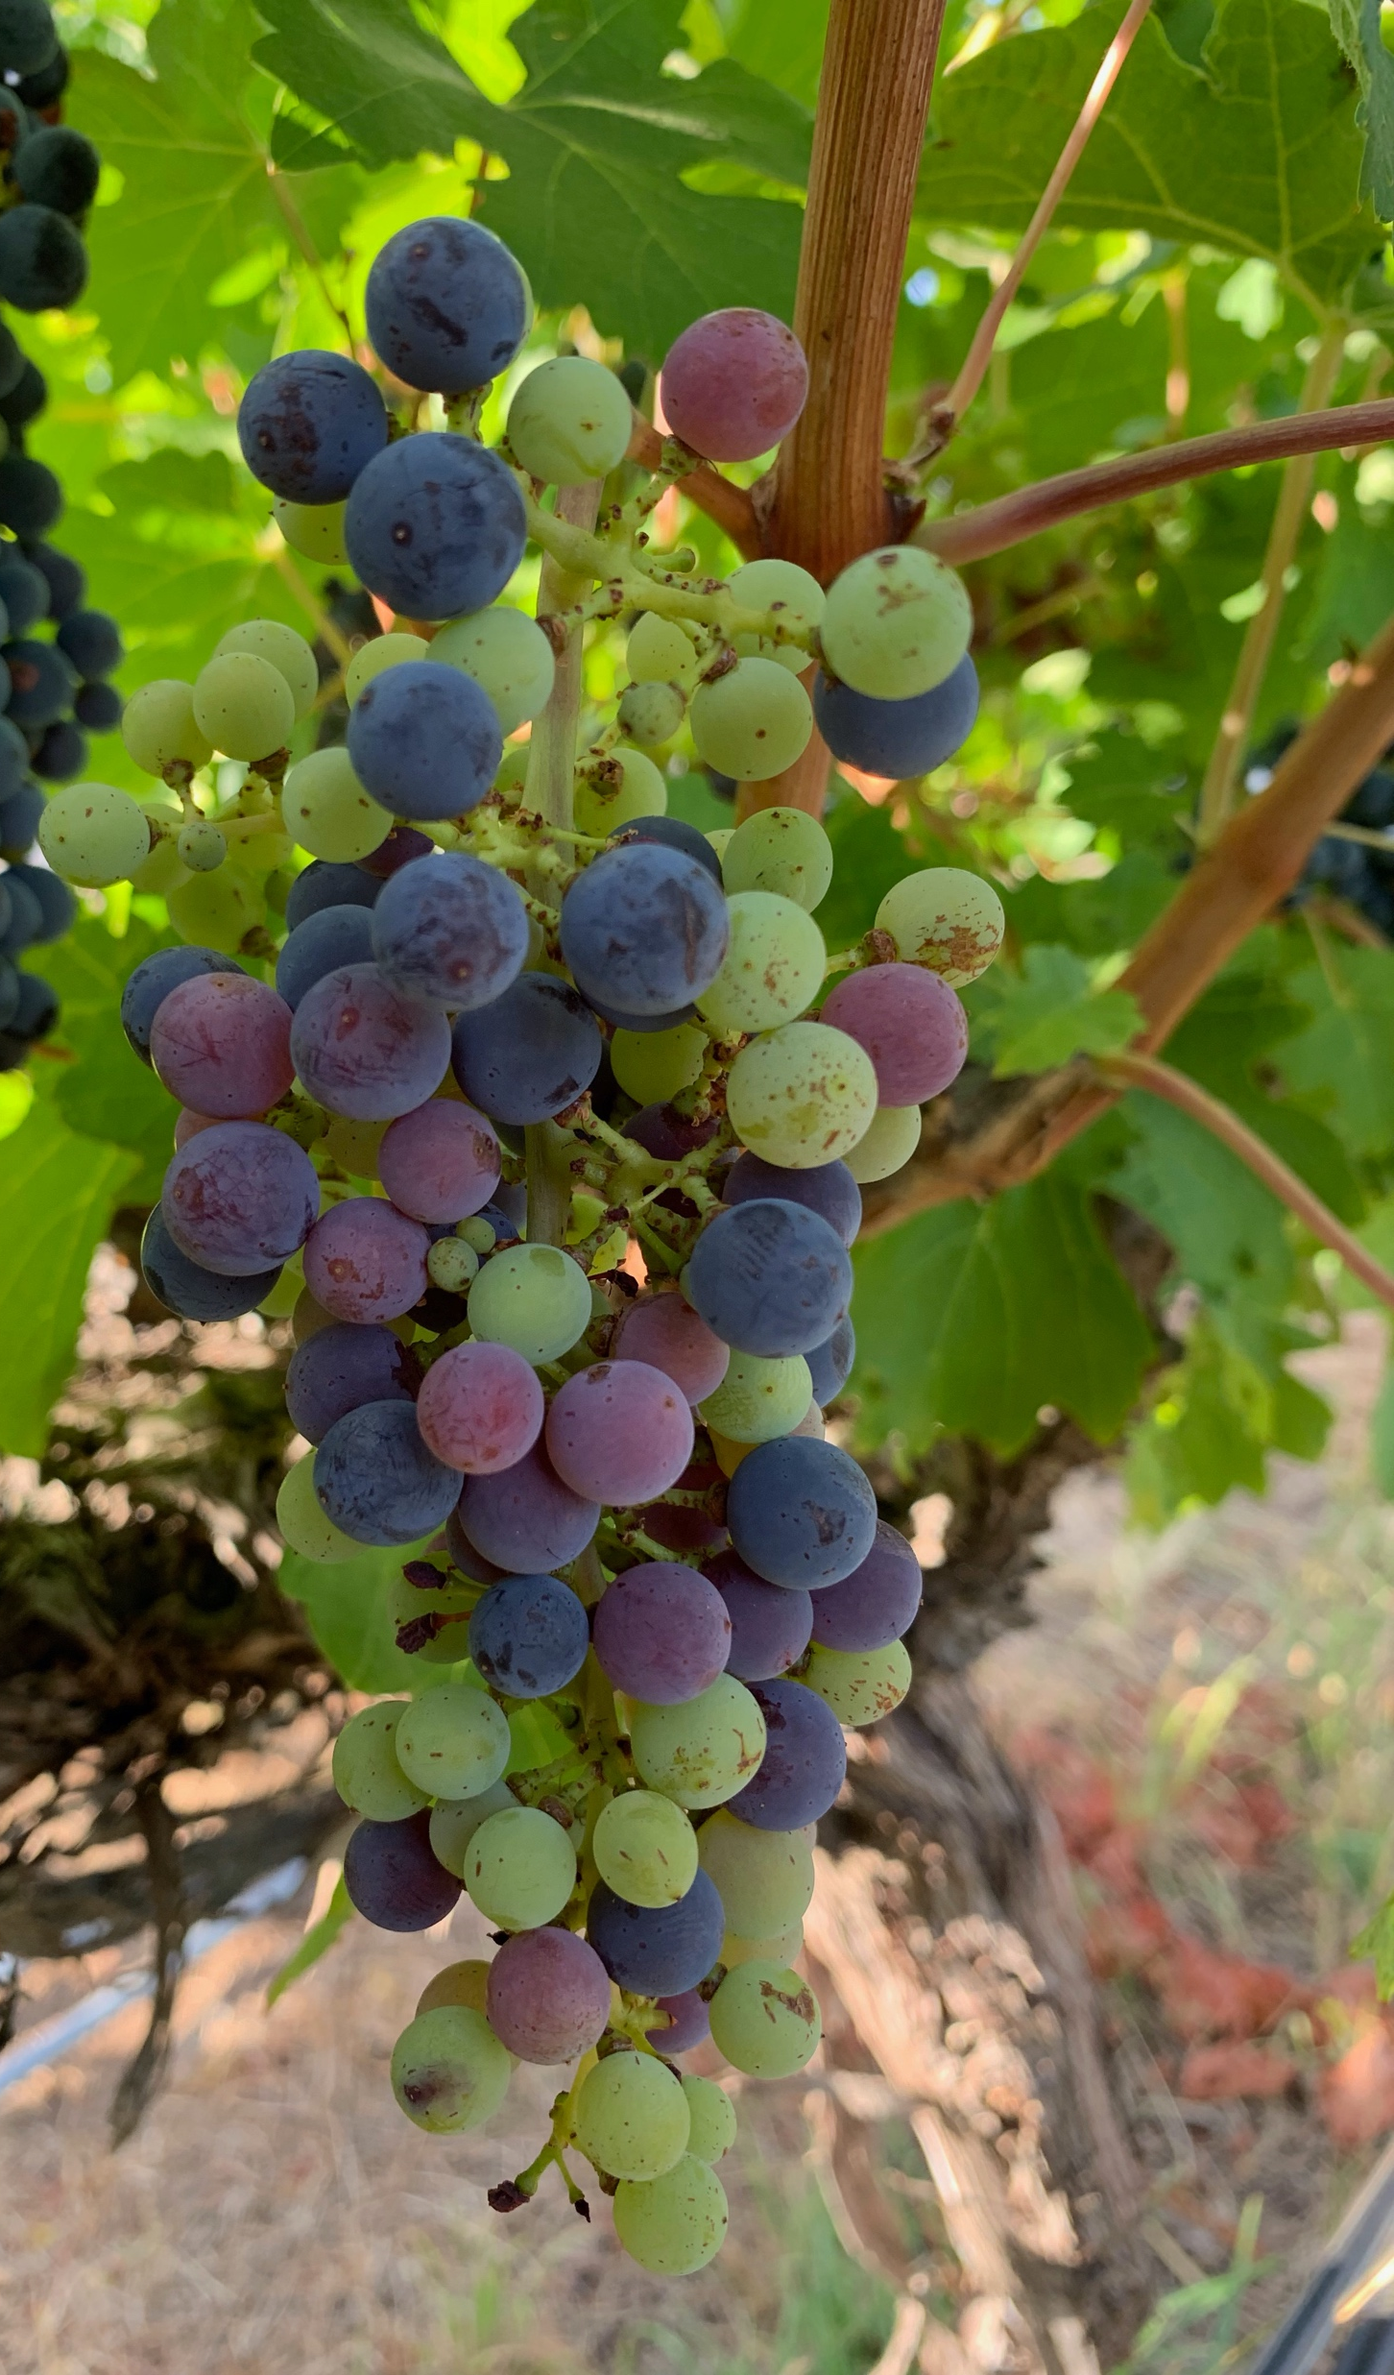
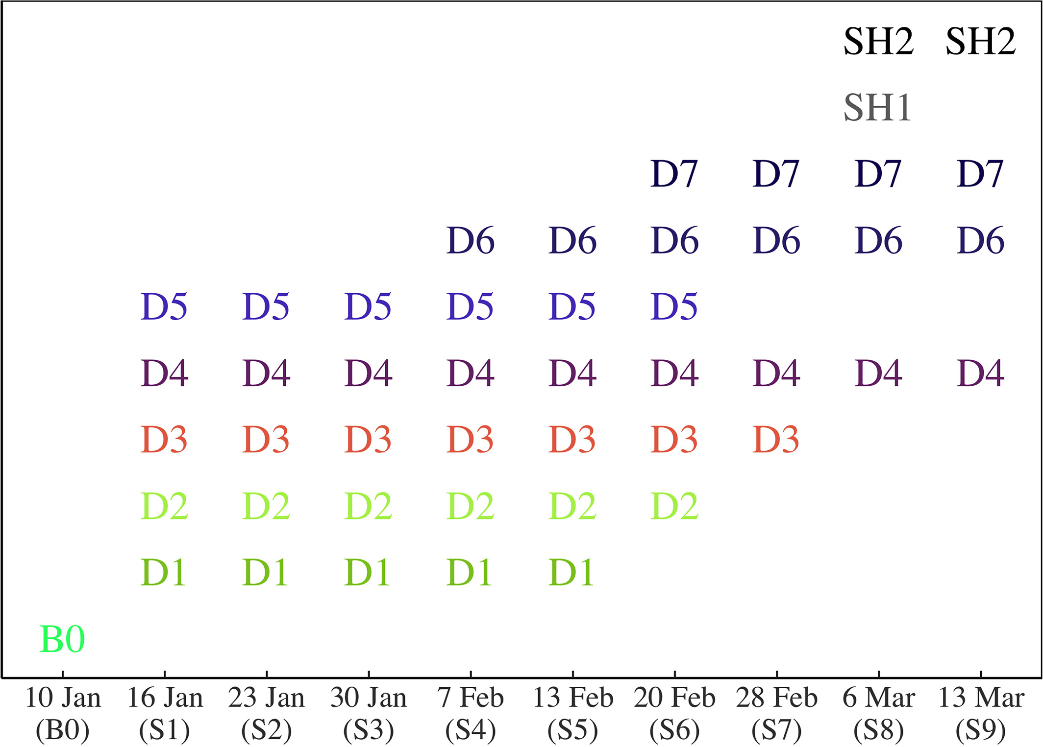
DEALING WITH AN ASYNCHRONOUS PROCESS
Sequential targeted sampling (9 weeks, ~750 berries)
Use of single berry approach advocated by Coombe et al., (1980, 1987)
Recently adopted in transcriptomics and other metabolic studies (Higginson et al., 2016, Shahood et al., 2020)
Inherent difficulties of analyzing single berries
Shrivelled (>30Brix)
Shrivelled (<30Brix)
Blue (>24Brix)
Blue (>20Brix)
Blue (<20Brix)
Purple/red
Pink/blush
Green soft
Green hard
Pre-veraison
Waite Campus, UofA, V2019
Previtali et al., AJGWR 2021
Slide 2

Slide 4
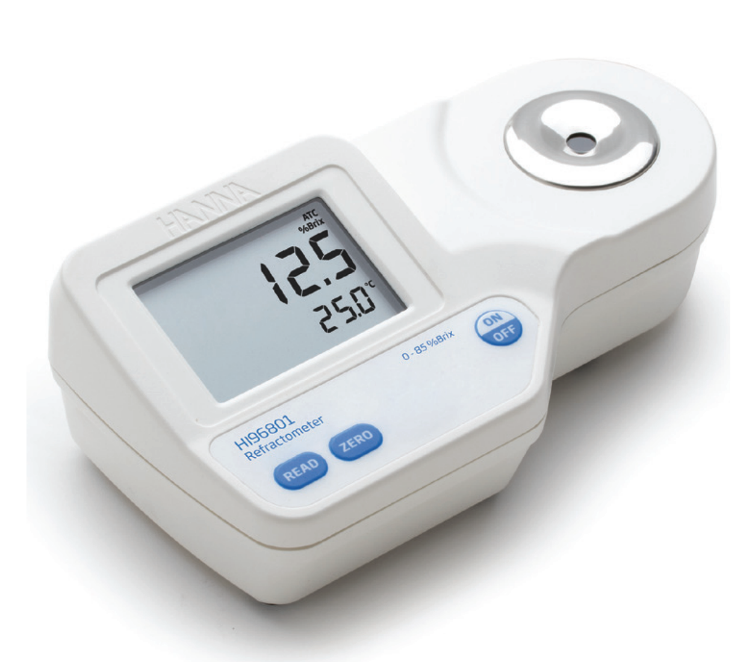
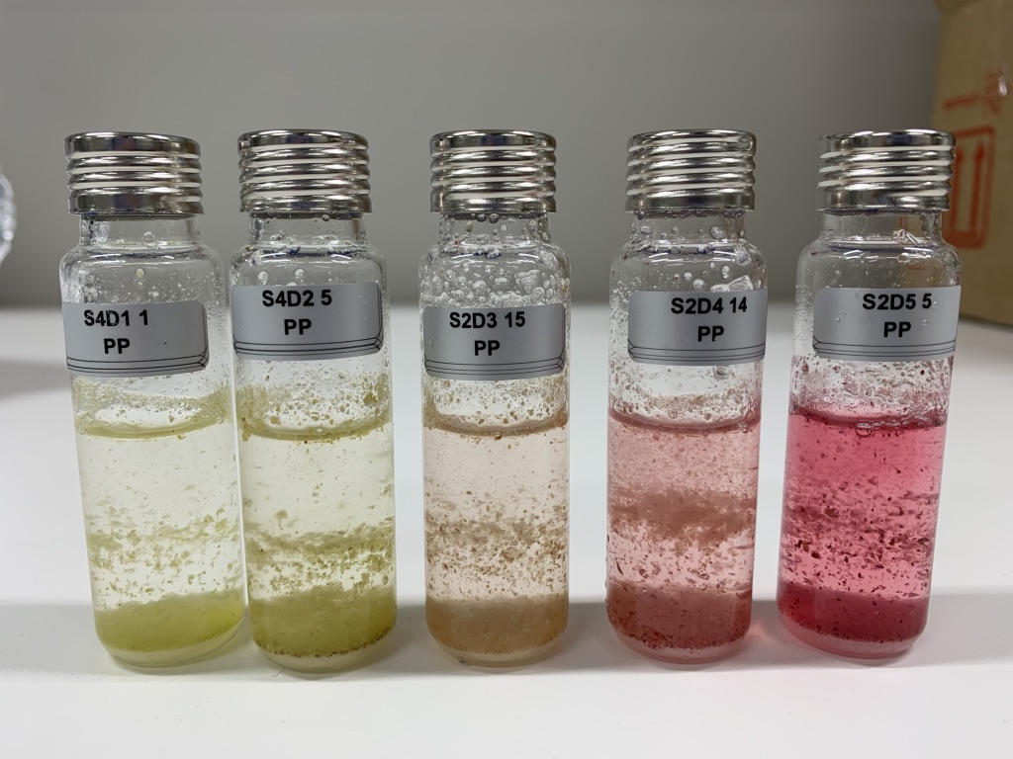
ANALYSIS OF SUGARS AND C₆ COMPOUNDS
r > 0.95, p < 0.001, n = 762
Sample preparation
(adapted from Capone et al., 2012)
Grinding in LN₂
TSS (°Brix)
~0.3 g powder
9.7 mL MQ H₂O
HS-SPME-GC-MS
hannainst.com
SIM method
Six C₆ compounds
~150 single berries
range (avg FM):
0.3 -1 g
Berry mass
Slide 3

Slide 5
LOX PATHWAY
Hexanal
(Z)-3-Hexenal
(E)-2-Hexenal
(E)-2-Hexenal
Compound
Hexan-1-ol
(Z)-3-Hexenol
(E)-2-Hexenol
Hexan-1-ol
(Z)-3-Hexenol
(E)-2-Hexenol
Concentration (µg/g berry)
Berry TSS (° Brix)
(Z)-2-Hexenol
(E)-3-Hexenol
(Z)-2-Hexenol
(E)-3-Hexenol
= quantified
Slide 4

Slide 6
Concentration
(µg/g berry)
Content
(µg/berry)
Slide 5

Slide 7
LIMITATIONS
Average per berry instead of skin/pulp
Free vs bound fraction
Inaccuracy of TSS readings
Slide 6

Slide 8
Wine Australia Supplementary Scholarship (PPA002459)
Wine Science group
E&J Gallo Winery staff
Chris Ford
(UofA)
Kerry Wilkinson
(UofA)
Nick Dokoozlian
(E&J Gallo Winery)

